Slide 1
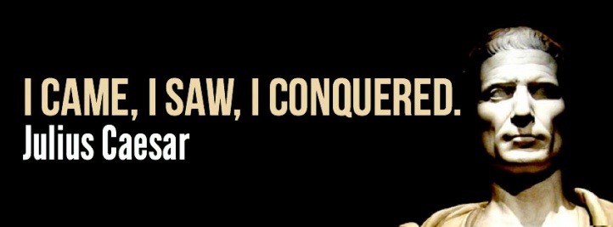
Day 6 Notes

Slide 2
RISE OF JULIUS CAESAR
75 BC Kidnapped by Pirates
60 BC
Formed the 1st Triumvirate
Caesar
Crassus
Pompey
59 BC Caesar elected Consul
58 BC Caesar given command of military in Gaul
wanted to be as great as Alexander the Great
55 BC Caesar conquered into Germany
but Senate did not give Caesar permission for this
with this victory, nearly doubled the size of Rome
BELONGED TO THE POPULARES PARTY

Slide 3
RISE OF JULIUS CAESAR
53 BC Crassus was killed by Parthians at a “peace meeting”
he was tricked
Parthians cut off Crassus’ head and poured gold down his throat
“now drink the metal for which you so lusted”
Crassus’ head was used in a play the next day
Triumvirate ended after death of Crassus
Pompey and the Roman Senate became allies
fearful of Caesar’s growing power and popularity
jealous of Caesar
called for Caesar to give up control of his legions

Slide 4
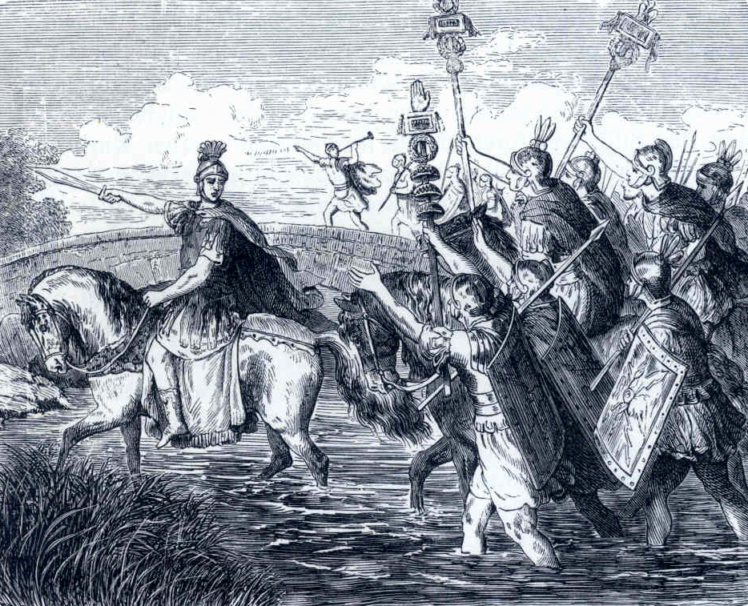
CAESAR “CROSSES THE RUBICON”
1/10/49 BC
Rubicon River was the southern border of Gaul (northern Italy)
there was a law that it made it treason to cross Rubicon
Caesar was viewed as an “Enemy of the State”
automatically started a “civil war”
Caesar - ”…the die is cast”

Slide 5
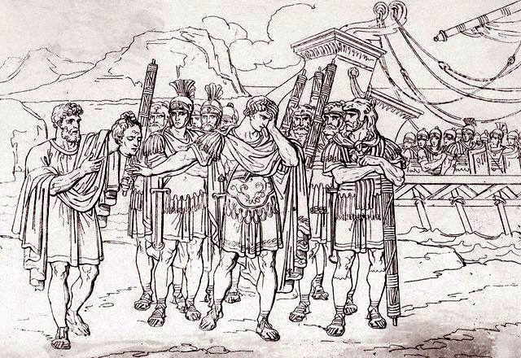
Battle of Pharsalus
8/9/48 BC
Caesar = 30K troops
Pompey = 140K troops
Caesar defeated Pompey
Pompey fled to Egypt
Egyptians gave Caesar Pompey’s
head
Caesar and Cleopatra
Cleopatra was brought to Caesar in rolled up rug
had a son
Caesarion
“Veni, Vidi, Vici”
I came, I saw, I conquered

Slide 6
CAESAR BECOMES DICTATOR
46 BC Caesar appointed “Dictator for 10 years”
at a festival, the crown of king was offered to Caesar…he refused saying, “I will not be king of Rome. Jupiter alone is King of the Romans.”
44 B.C. Caesar – “Dictator for life”
had supporters placed into political positions
increased Senate to 900 members
to support his goals and decisions

Slide 7
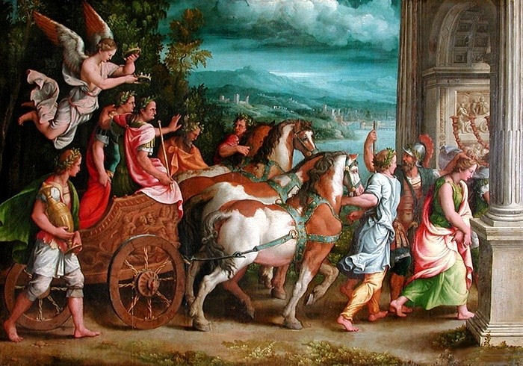
“MILITARY TRIUMPH”
greatest honor for a commander was to be awarded a “Triumph”
marched through Rome with army, “spoils of war”, led by the chiefs of the conquered people, who were executed afterward
Triumphal General” had his face and arms painted red, rode in a cart pulled by two white horses

Slide 8
IDES OF MARCH
March 15, 44 BC
a “Seer” had told Caesar to “beware the Ides of March”
Caesar’s wife had a vision… told him not to go to the Capital
when Caesar got to Capital Caesar was given a note that the Senators were going to kill him…he ignored the note
Feared Caesar was ending the Republic
Caesar was leaving for Parthia on March 18 and the conspirators feared if they waited Caesar would return stronger than ever
Caesar was assassinated

Slide 9
CAESAR’S
ACCOMPLISHMENTS
doubled the size of Roman territory
expanded Roman citizenship
granted citizenship to many provinces that had helped him
pardoned many people who had opposed him
Did not rule by a “Reign of Terror”
Julian calendar
later became basis for modern calendar
Public Works Programs
Land to poor

Slide 10
2ND TRIUMVIRATE
“Avenge” Caesar’s death
Octavian
had been appointed by Caesar to replace him (NOT Caesarion, Cleopatra’s son)
Mark Antony
Lepidus
After avenging Caesar’s death, rivalries developed among 2nd Triumvirate
Octavian (west) and Antony (east) split the empire
”this town is not big enough for the both of us”
Antony fell in love with Cleopatra
8.2.31 BC Battle of Actuim
Octavian defeated Antony
Antony and Cleopatra committed suicide to prevent
being paraded through Rome on Octavian’s “Triumph”

Slide 11
RISE OF EMPEROR AUGUSTUS
Octavian returned to Rome victorious
Senate gave him title “Augustus”
Augustus preferred term “1st Princeps”
“first among equals”
regarded as 1ST EMPEROR

Slide 12
END OF ROMAN REPUBLIC
Civil Wars / Military loyalty to Generals
Marius v. Sulla
Caesar v. Senate and Pompey
2nd Triumvirate
Political Violence
Political assassinations
“Party Politics”
Optimates v. Populares
Population Growth / Inequality
Julius Caesar
end of “democratic process”

