Slide 1
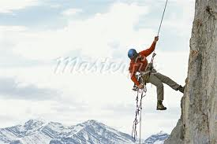
THE ROPE

Slide 2
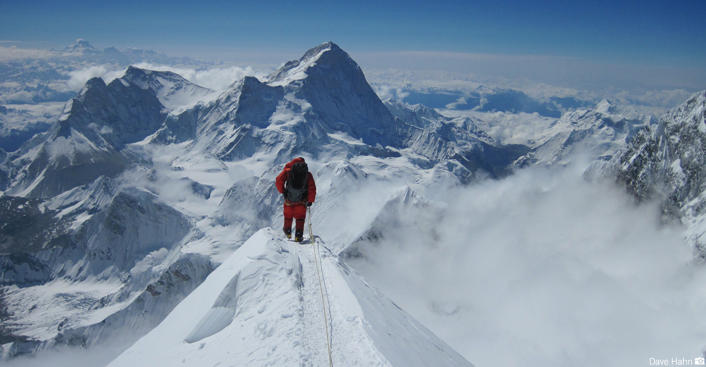
This story is about a mountain climber, who wanted to climb the highest mountain, Mt. Everest. He began his adventure after many years of preparation, but since he wanted the glory just for himself, he decided to climb the mountain alone.

Slide 3
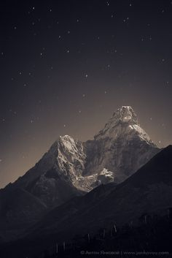
As he continued his climb, up the mountain, the night conditions became heavy. There was zero visibility, the clouds covered the moon and the stars.

Slide 4
As he was climbing, only a few feet from the top of the mountain, he slipped and fell, falling at a great speed. The climber could only see black spots as he was being sucked down by gravity. He kept falling and falling and in those moments of great fear, he began to replay all the good and bad moments of his life.

Slide 5
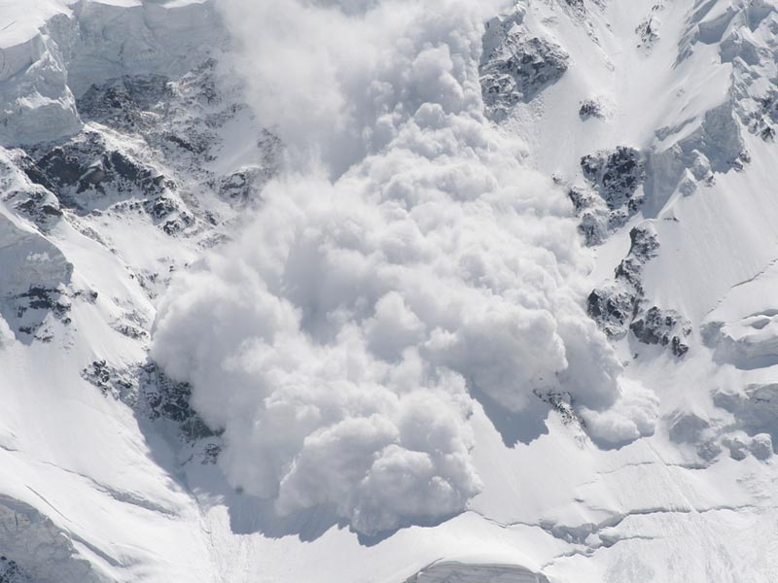
He was thinking now about how close death was getting, when all of a sudden he felt the rope tied to his waist pull him very hard. His body was hanging in the air… Only the rope was holding him and in that moment of stillness he had no other choice but to scream: Help me GOD!!!

Slide 6
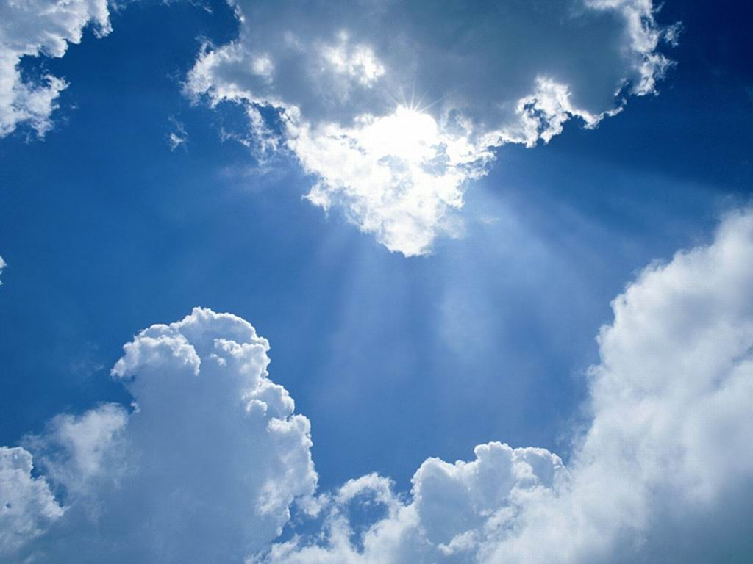
All of a sudden a deep voice coming from the sky answered…what do you want ME to do?
Save me God!!
Do you really think I can save you?
Of course I believe you can!!
THEN CUT THE ROPE!!!

Slide 7
There was a moment of silence…

Slide 8
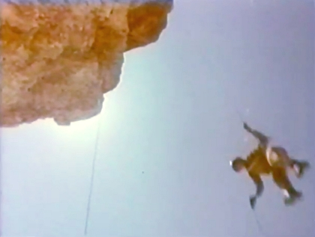
The rescue team tells, that the next day a climber was found dead and frozen…his body hanging from a rope. His hands holding on tight to it…
Only 5 feet from the ground!!!
IS THIS MOST PEOPLE’S VIEW OF GOD?

Slide 9
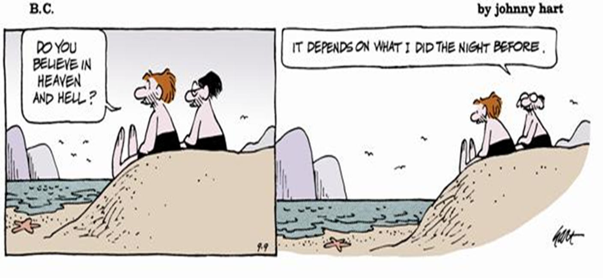
OR IS THIS A MORE CONVENIENT FOR YOU?

